Slide 1
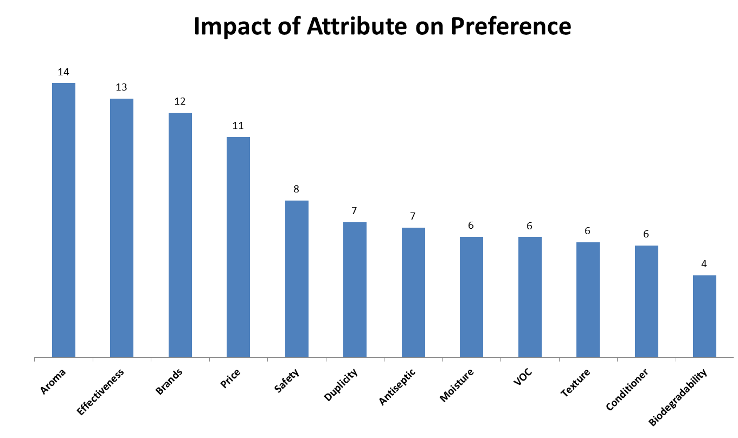
Importance of Aroma, Effectiveness, Brand and Price
on Brand A Preference
The aroma, effectiveness, brand and price of Brand A had the greatest impact on choice. The impact of those four attributes was approximately three times more than the impact of biodegradability, the attribute with the least amount of impact on preference.
(Base size = Total Sample, N=301)

